Slide 1





SUSTAINABLE FARMING AND CRITICAL HABITAT CONSERVATION TO ACHIEVE BIODIVERSITY MAINSTREAMING AND PROTECTED AREAS MANAGEMENT EFFECTIVENESS IN WESTERN CAMEROON
– SUFACHAC-
(GEF Project ID: 5210/ ADDIS No. 00909)
TABLE RONDE NATIONALE DES PROJETS EN COURS FINANCES PAR LE FEM AU CAMEROUN
| ZABOYA DAMA Adèle Epse MAKOMRA |
zaboyadele2006@yahoo,fr
| 7th August 2025|

Slide 2
1. General Presentation of the Project
Zone(s) administrative d’intervention: Kupe Manengouba; Lebialem, part of Manyu (South West Region-Cameroon) -3 PAs (BNP, BMWS, THWS)
Durée et phase actuelle: 48 Months -3rd Extension
Objectifs principaux:
To strengthen and expand the Protected Areas network in Bakossi Banyang Mbo landscape;
To improve the Sustainability of Protected Area Systems;
To mainstream Biodiversity conservation ant its sustainable use into production landscapes in link with communities and private sector.
Mécanismes de coordination: EA (MINEPDED); TM (UNEP); SC; PMU
Budget global du projet (Bailleur et cofinancements) :
GEF financing amount: USD 1,716,895.00
Co-financing amount: USD 6,112,840.00

Slide 3
2. Context and justification
Domaines thématiques d’intervention du FEM adressées
  Biodiversity
Alignment to national Priorities (SND30; NBSAP2, CDN, PNACC, AFR100, Stratégie de gestion des déchets, etc....)
1. Biodiversity Conservation: NDS30, NBSAP2, AFR100 aims to strengthen ecosystem management and biodiversity conservation and restauration which is at the heart of the SUFACHAC project.
2. Sustainable Development: The sustainable agricultural practices promoted by SUFACHAC support NDS30’s; objectives of promoting inclusive economic development while preserving natural resources and working for landscapes restoration .
3. Local Capacity Building: The project works with local communities by developiyng participatory approaches, which is in line with the NDS30's objective of involving citizens in resource management.
4.IGAs : By developing economic alternatives for communities, the project contributes to reducing unemployment which is a priority of the NDS30.

Slide 4
3. KEY RESULTS
Component | Progress | Partners | RATING
Cpt 1: Critical wildlife habitat conservation through creation / strengthening of Protected areas | 1 TOU created and Environmental Conformity for 3 PAs engaged. Management Effectiveness (METT) score realized; | MINFOF, ERUDEF | 87.5%
Cpt 2: Sustainable farming practice and promotion of communities’ livelihoods and biodiversity conservation through Integral Environmental and Social Management Plans | Specific regulatory framework drafted; 2 guidelines and 3 handbooks for Public Participation in environmental process available; several trainings on forest use techniques and sustainable farming completed in 2 Divisions; Participatory IGAs developed and supported for riparian communities alongside the PAs | MINEPDED Local services, MINEPIA, MINADER, MINRESI CHEDE, ERUDEF | 78.6%
Cpt 3: Knowledge Management, monitoring and evaluation | Baseline studies of the landscape completed; priority sites for socio-economic development, biodiversity conservation, and provision of ecosystem services in BBML landscape are identified | MINEPDED, CHEDE, ERUDEF, MINRESI, Universities, MINFOF | 88.8%,
The overall global rate of the project round 84.96% .
The remaining 15.04 % of activities are in progress/ to be executed within the months ahead.

Slide 5
3. KEY RESULTS
01 draft text (Ministerial Order) taking into consideration Biodiversity, HCV, HCS and climate changes in ESIAs Studies developed .
01 guideline on best practices for the treatment of Biodiversity (HCV), Carbon Stocks (HCS), and socio-economic impacts of development and conservation projects
03 partnership signed with local NGOs and Civil Societies for the realisation of impact activities in Bayang-Mbo, Bakossi and Lebialem Areas
Communication tools and Platforms available (Newsletters, 05radio spots, charts, posters, leaflets; on environmental subjects throughout the landscape; women IGA networks ; Project Information windows online) .
30 billboards for PAs boundary demarcation designed and planted in the PAs in collaboration with communities
01 draft text (Ministerial Order) taking into consideration Biodiversity, HCV, HCS and climate changes in ESIAs Studies developed .

Slide 6
3. KEY RESULTS
01 guideline on best practices for the treatment of Biodiversity (HCV), Carbon Stocks (HCS), and socio-economic impacts of development and conservation projects
03 partnership signed with local NGOs and Civil Societies for the realisation of impact activities in Bayang-Mbo, Bakossi and Lebialem Areas
designing, development and management of the portal web site for project information sharing (01 Web site, 01 Facebook page, 01 Youtube Channel) created and available.
Edition and dissemination of newsletters on the project activities
05 Radio spots developed on conservation issues and broadcasted in local radios , more than 30 billboards for PAs demarcation designed and planted in the PAs boundaries in collaboration with communities
More than 10 awareness campaigns both local and regional

Slide 7
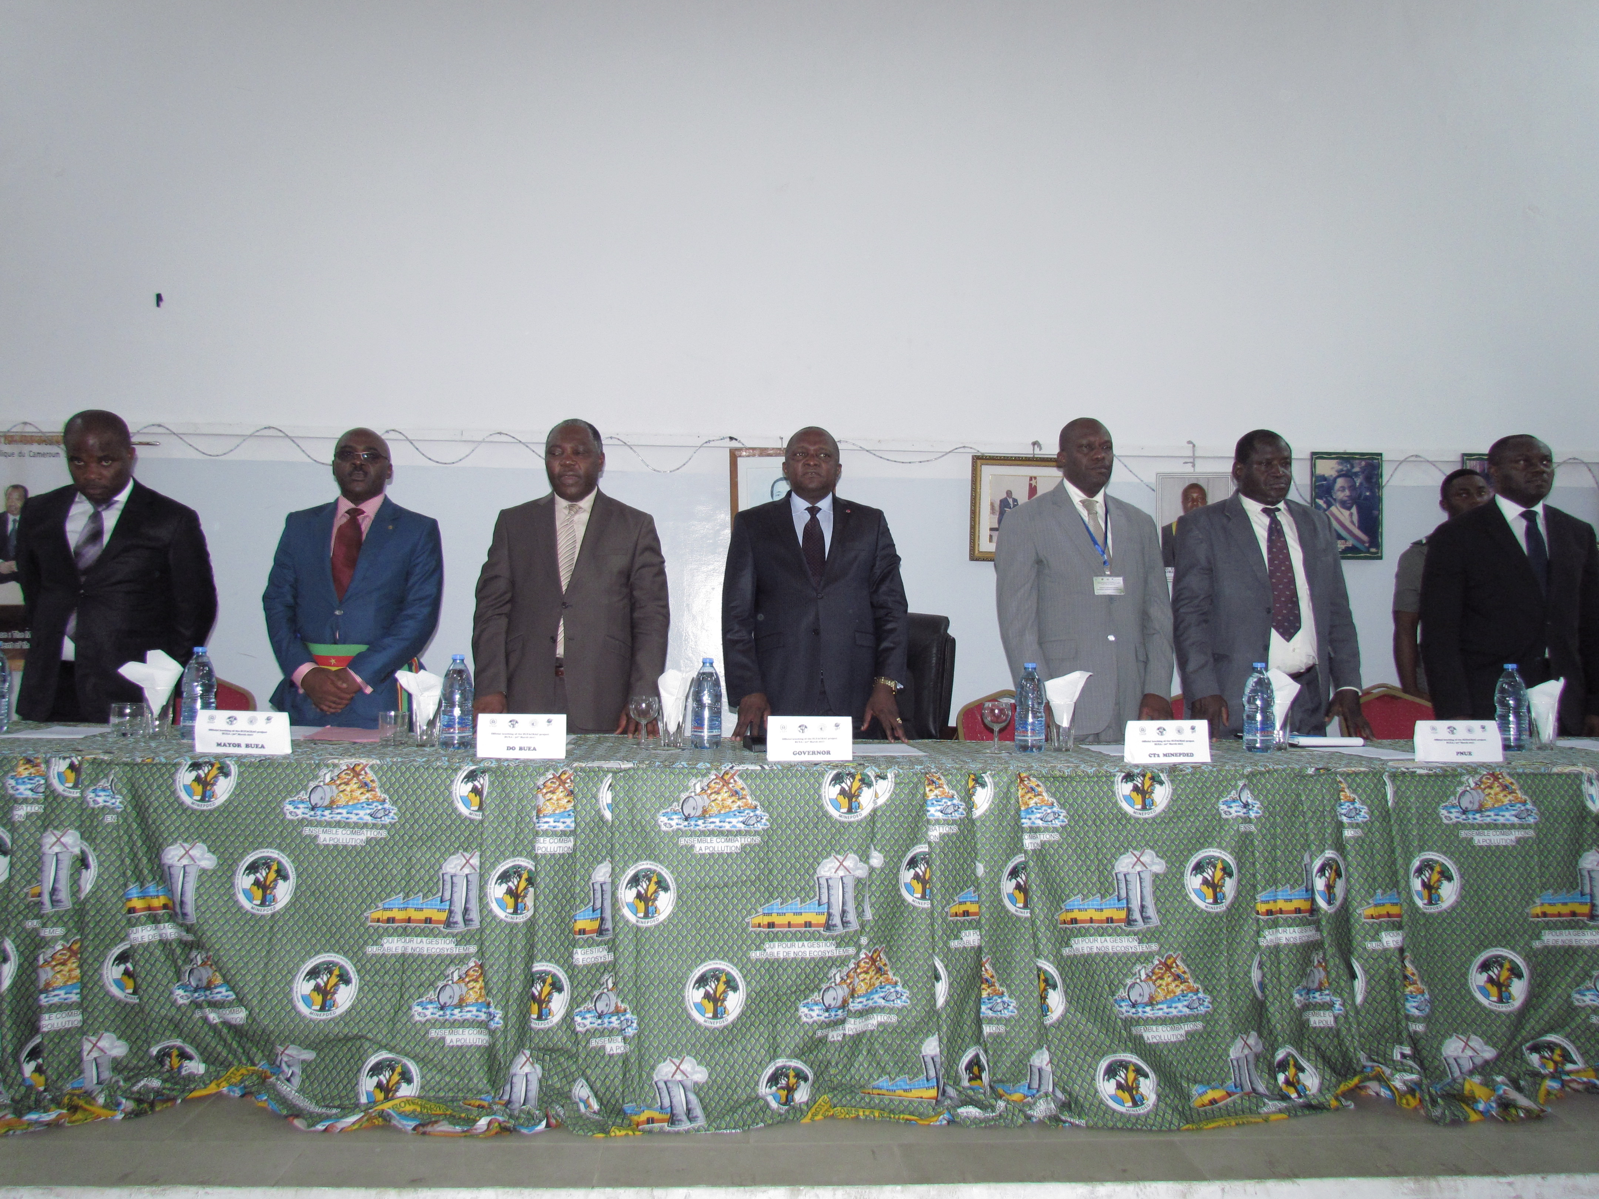
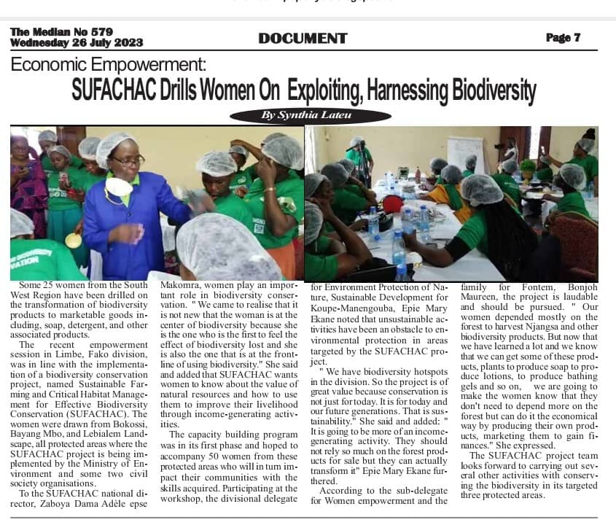
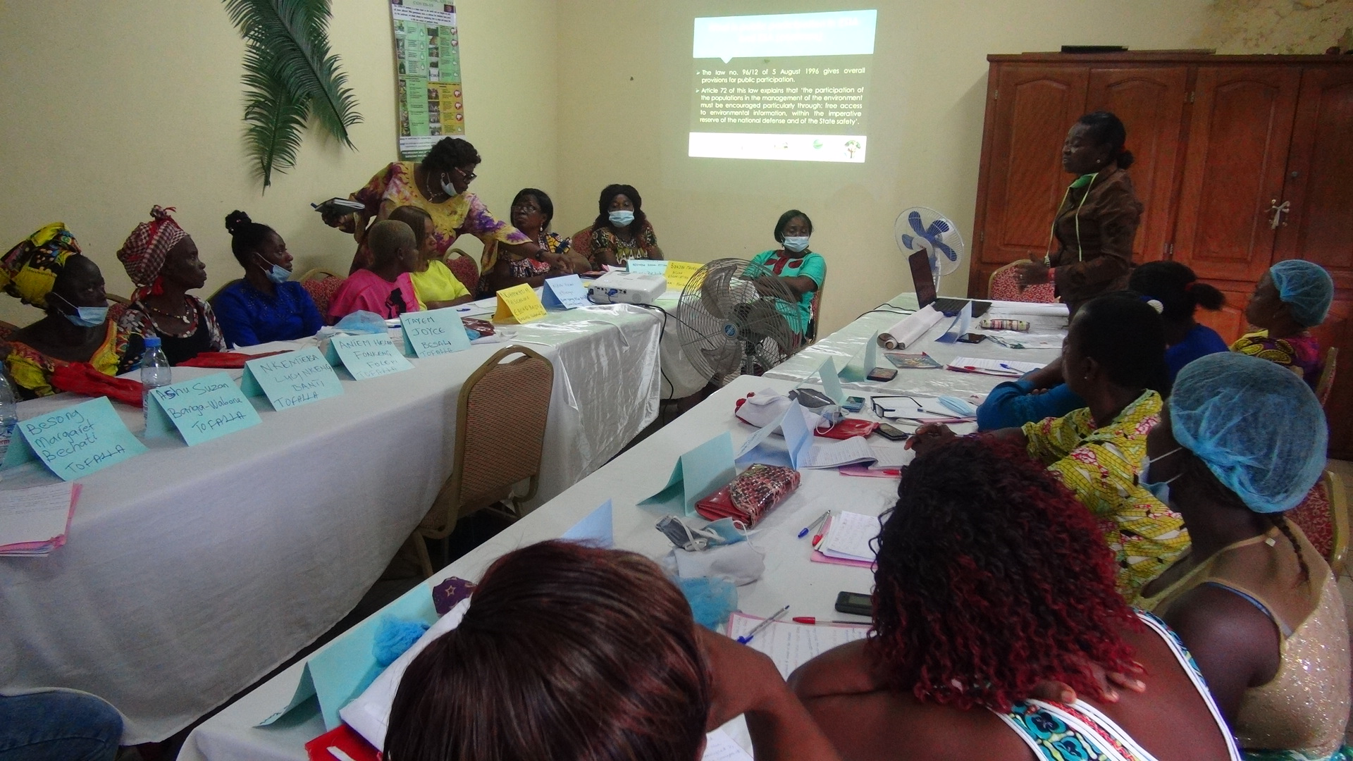
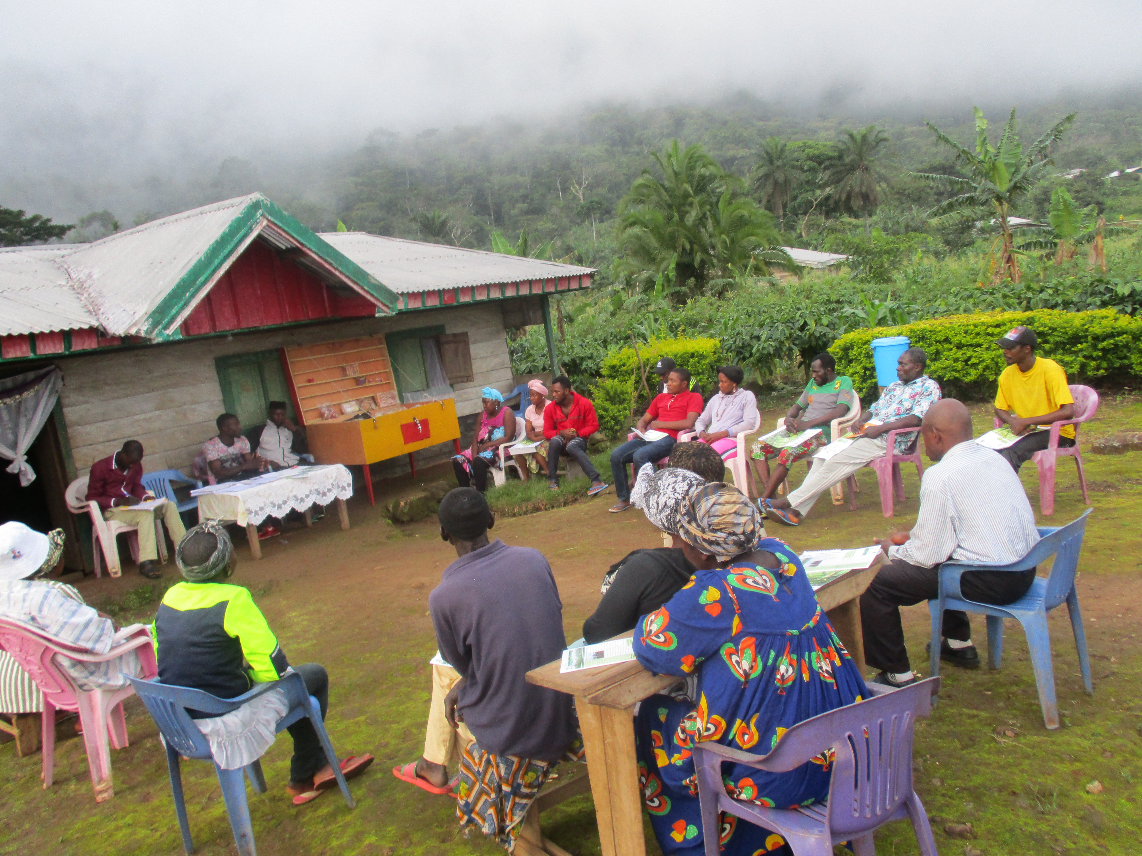
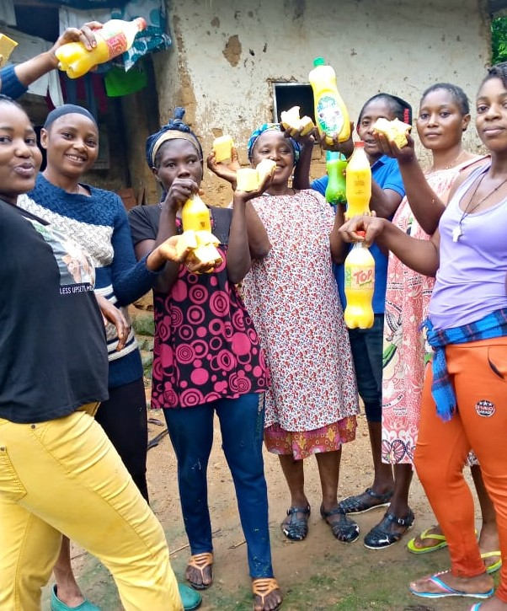
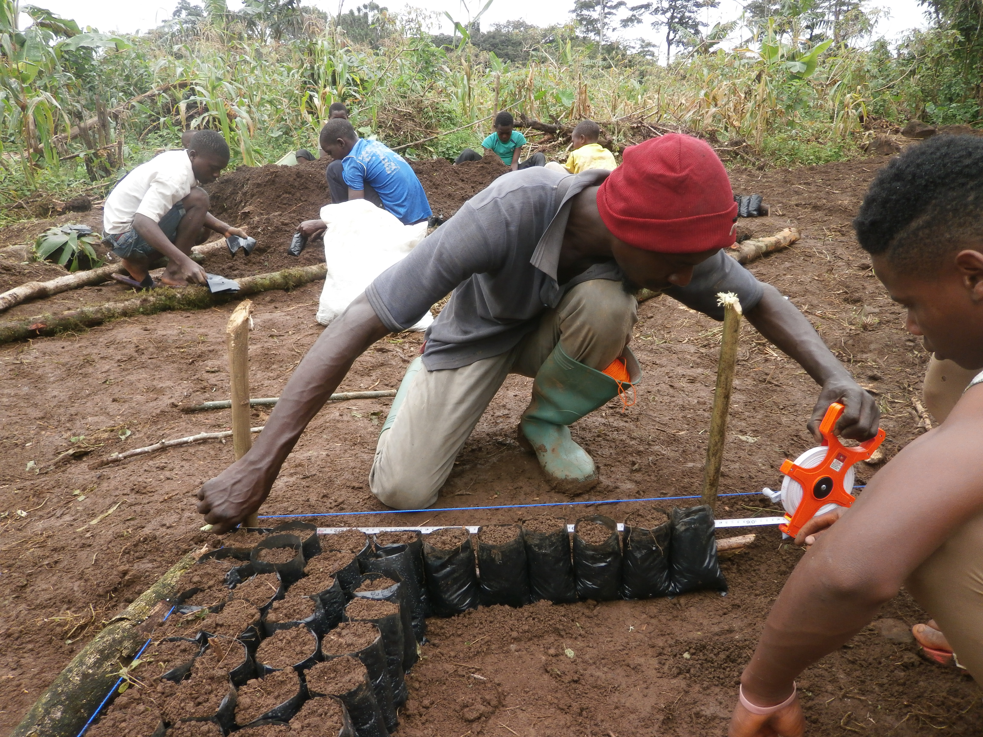
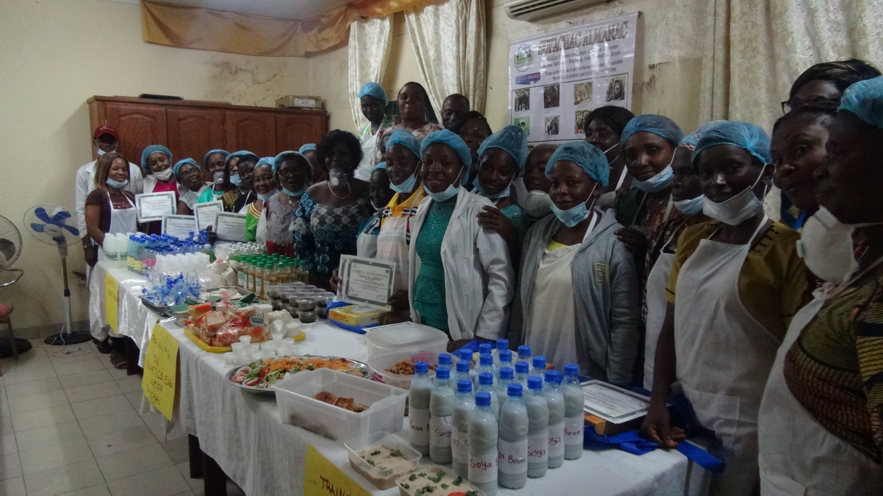

Slide 8
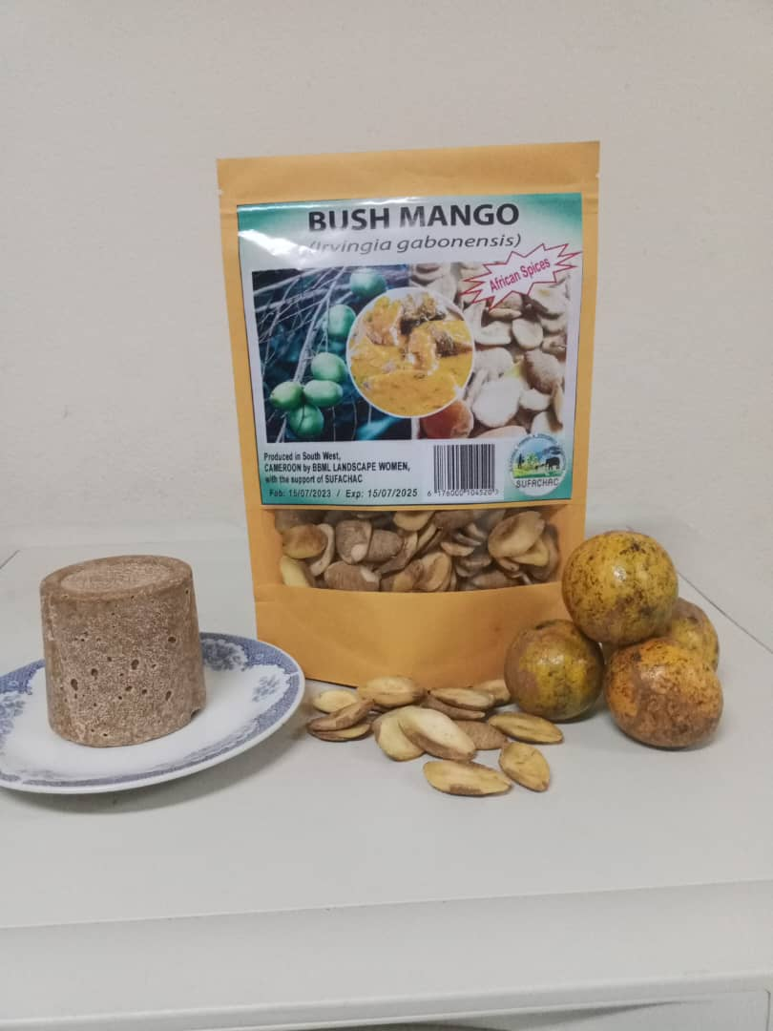
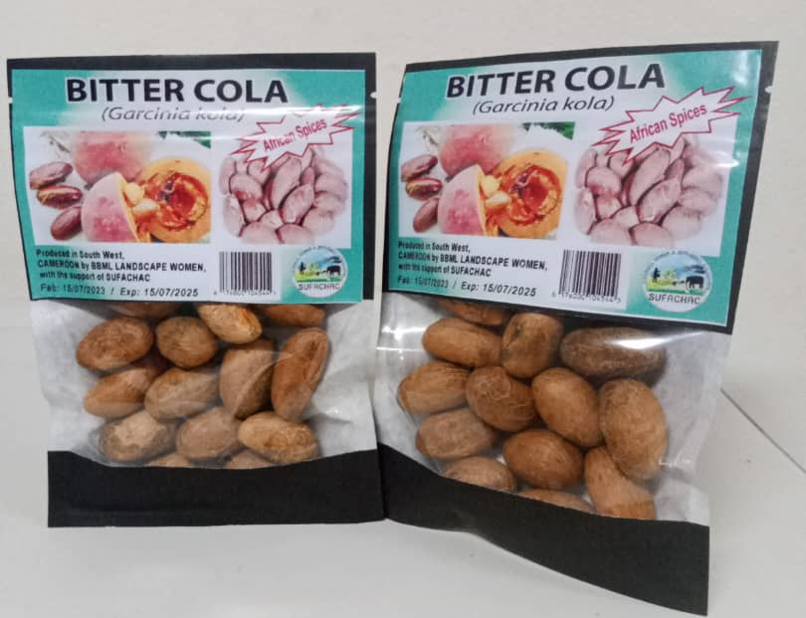
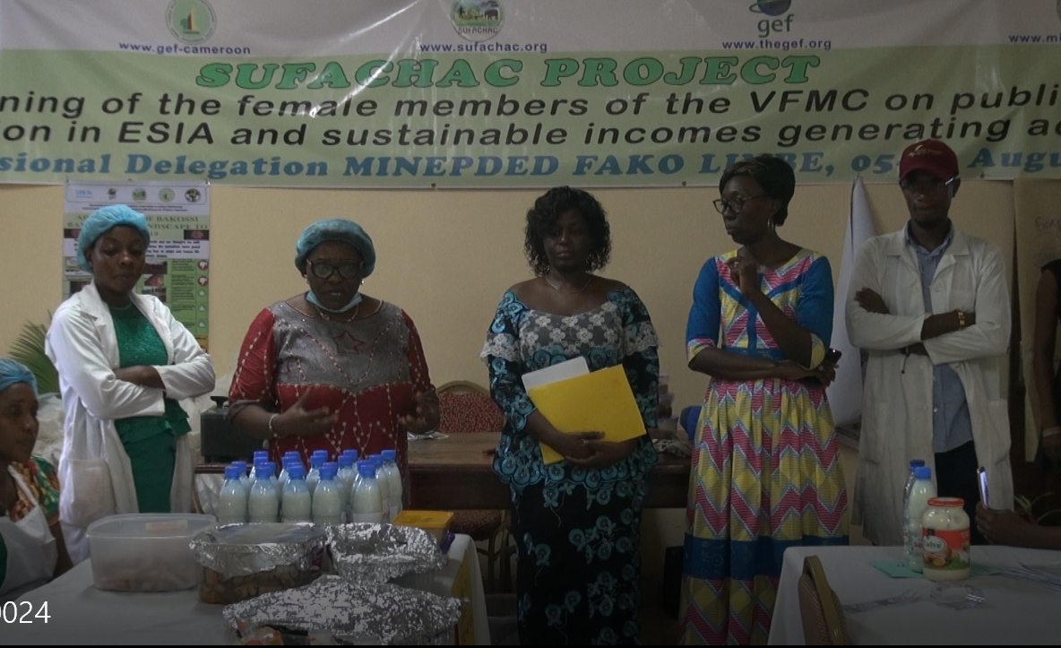
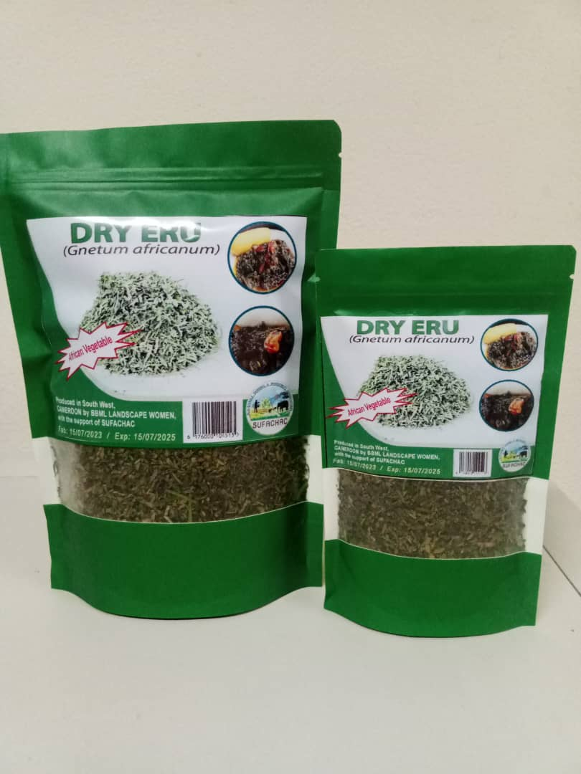
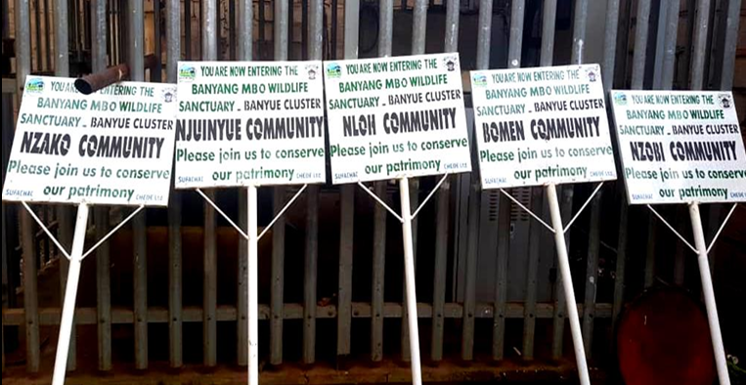

Slide 9
Mainstreaming Biodiversity and Gender with SUFACHAC
Private Sector
NGOs, Cooperatives; CIGs
Local stakeholders of relevant Governmental entities at regional and Divisional level
Community leaders, village organizations, women and youth leaders, communities associations
Private Sector

Slide 10
4. Key Results and impacts on the field
Indicators category and concret examples
Indicateurs Environnementaux
Environmental Baseline information of the landscape completed
Awareness on Legal and institutional environmental framework realized
NB: Donner les illustrations pour chaque exemple.L'utilisation efficace de ces indicateurs nous permet non seulement de mesurer notre impact actuel, mais aussi d'orienter nos stratégies futures pour maximiser notre influence positive sur l'environnement et les communautés que nous servons.

Slide 11
Bénéficiaires Directs et Indirects
5000 individual peoples touched by the Project awareness on Biodiversity conservation;
200 local authorities and administrations sensitized in 03 Divisions on environmental sustainability
53 villages beneficiated of activities on Biodiversity conservation and livelihood improvement
20 VFMC reinforced

Slide 12
Indicateurs Sociaux
Significant Increasement of awareness and social responsibility towards natural resources of the Project landscape
Economic emporwment of PA riparian communities realized

Slide 13
5. Partnerships, collaboration and communication
MINEPDED role and other stakeholders:
MINEPDED: Cofinancing; administrative and Technical Coordination; Execution
Sectorial Administrations : Technical Coordination and follow-up
Collaborations with Councils, Civil Society etc.: Council authorities trained on environmental framework and public participation ; implementing partners from SCOs: CHEDE; ERUDEF
Key Partners: UNEP;MINEPAT; CHEDE;ERUDEF; MINFOF; MINADER; MINEPIA

Slide 14
6. Difficulties Encountred and Lessons Learnt
Technical , financial, social constraints:
When the Socio-political crisis started it was difficult to reach the field and to fulfill most of our objectives ;
Funds mobilization (main and co-financing) schedules did not always match the operationalization plans to enable the achievement of some targets on time,
COVID-19 that held to a break in our meetings and field activities for weeks:
Correctives measures:
a- We had to delocalize stakeholders to secure people during our activities
b- we had to put in place and educate our stakeholders on to use of online mechanisms toreach some of our objectives
Lessons Learnt:
Conservation projects need to capitalize in the field in good collaboration, on existing opportunities of the landscape to avoid duplication on activities and mismanagement of financial/material resources.
Efficiency and effectiveness in Biodiversity conservation is ensured by participatory PAs management and development of riparian communities livelihood in a bottom to top approach
Best practices to be valorized
Evaluation of partners and consultants reports by Technical Working Group.
Participatory approaches and community management in Biodiversity Conservation

Slide 15
7. Perspectives and recommendations
Next steps :
sharing of the project results
Capitalization Proposals :
-Informations gathered on the landscape could be capitalized in further initiatives/projects to avoid duplication and loss of resources
-The improvement of main economic value species realized within the project timeframe with communities can be strengthen
Needs :
-Financial means to capitalize lessons learnt from SUFACHAC Project to a wider audience

Slide 16

THANK YOU FOR YOUR KIND ATTENTION
www.sufachac.org
sufachacproject@gef-cameroon.org

